Slide 1
Software Change, Evolution and Maintenance

Slide 2
Introduction
Software maintenance is an important activity, which keeps a system remain useful during its lifetime.
Maintenance is performed after the system is deployed at the customer site.
As the customer starts working on the system, the system and its parts may introduce defects.
Some new feature may be added/deleted to the system if the customer needs change.
Organizational operating environment and policies change from time to time, which causes a system to be transported or adapted to a new environment.

Slide 3
Introduction
Software maintenance is valuable to avoid software aging and to maintain the quality of software product.
Without software maintenance and evolution, system becomes complex and unreliable.
The cost of software change varies from project to project and with the types of changes.
A survey indicates that the software maintenance or change consumes 60–80% of the total life cycle cost.
Major software cost is incurred due to enhancement (75–80%) rather than correction.

Slide 4
Software Change
Lehman’s laws of software evolution state that a successful software product undergoes changes over time.
The main propose of change is to satisfy the changing needs of the user.
The change can be related to correcting faults, adapting to some new environment, or to completely changing the software system with a new platform.
Software change is inevitable in the organization.

Slide 5
Software change trends
Conformance to business needs
Initial development
Evolution
Maintenance
Reengineering
New
system
Innovations
Servicing
Migration
Time

Slide 6
Software Evolution
Evolution is inevitable for software systems.
Due to various reasons, software systems need to change. The Lehman believed that software is a tool to mechanise the real world.
He claimed that since the real world is dynamic, so the software should get changed and updated to be able to reflect the changes in the real world.
Software evolution is important to keep the software remain productive within a changing environment.
Evolvability is defined as the capability of software products to be evolved to continue to serve their customers in a cost-effective way.

Slide 7
Lehman's laws
Lehman's laws essentially describe software evolution as a force that is responsible for both driving new and/or revising the existing developments in a system.
Lehman offered eight laws after the survey of large systems.
All the laws relate to E-type systems.
E-type systems are the software systems that solve a problem or implement a computer application in the real world
Software concentrates more on quality issues, such as interoperability, portability, usability, reliability, and robustness; and it is sometimes referred to as industrial quality software

Slide 8
Lehman's laws for software evolution
Number | Name | Description
I | Continuing change | An E-type program that is used must be continually adapted else it becomes progressively less satisfactory.
II | Increasing complexity | As a program is evolved, its complexity increases unless work is done to maintain or reduce it.
III | Self-regulation | The program evolution process is self-regulating with closeness to normal distribution of measures of product and process attributes.
IV | Conservation of organizational stability (invariant work rate) | The average effective global activity rate on an evolving system is invariant over the product lifetime.
V | Conservation of familiarity | During the active life of an evolving program, the content of successive releases is statistically invariant.
VI | Continuing growth | Functional content of a program must be continually increased to maintain user satisfaction over its lifetime.
VII | Declining quality | Software programs will be perceived of declining quality unless rigorously maintained and adapted to a changing operational environment.
VIII | Feedback system | E-type programming processes constitute multi-loop, multi-level feedback systems and they must be treated as such to be successfully modified or improved.

Slide 9
Software Maintenance
IEEE defines, “software maintenance is the process of modifying a software system or component after delivery to correct faults, improve performances, or other attributes; or adapt to a changed environment.”
The main purpose of maintenance is to keep the system up and running after delivery.
Pigoski states, “Software maintenance is the totality of activities required to provide cost-effective support to a software system. Activities are performed during the pre-delivery stage as well as the post-delivery stage. Pre-delivery activities include planning for post-delivery operations, supportability, and logistics determination. Post-delivery activities include software modification, training, and operating a helpdesk

Slide 10
Categories of Maintenance
Corrective maintenance
  fixing defects or failures
Adaptive maintenance
  changes due to operating environment changes
Perfective maintenance
  improve performance or maintainability
Preventive maintenance
  update the software in anticipation of any future problems
Emergency maintenance
  repair or replacement of facility components or equipment requiring immediate attention

Slide 11
Maintenance Process Models
The process models organize maintenance into a sequence of related activities, or phases, and define the order in which these phases are to be executed.
Some models are:
  Quick-Fix Model
  Osborne’s Model
  Iterative-Enhancement Model
  Full-Reuse Model
  IEEE 1219 model
  ISO-12207 model

Slide 12
Quick-Fix Model
The quick-fix model is an ad hoc approach to the maintenance
Its approach is to work on the code first and then make necessary changes to the accompanying documentation
The idea is to identify the problem and fix it as early as possible.
After the code has been changed, it may affect requirement, design, testing; and any other form of available documents impacted by the modification should be updated.
Due to time constraint, this model does not pay attention to the long-term effects.
Changes are often made without proper planning, design, impact analysis, and regression testing.
Also, repeated changes may demolish the original design, thus making future modifications progressively more expensive to carry out.

Slide 13
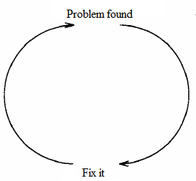
Quick-Fix Model

Slide 14
Osborne’s Model
The Osborne’s model is concerned with the reality of the maintenance environment.
This model assumes that the technical problems that arise during maintenance are due to poor communication between and control of the management.
According to the Osborne strategies, maintenance requirements need to be included in the change specification; a quality assurance program is required to establish quality assurance requirements, and a metrics needs to be developed in order to verify that the maintenance goals have been met.

Slide 15
Iterative-Enhancement Model
This model considers that making changes in a system throughout its lifetime is an iterative process.
The iterative-enhancement model assumes that the requirements of a system cannot be gathered and fully understood initially.
The system is to be developed in builds. Each build completes, corrects, and refines the requirements of the previous builds based on the feedback of users.
The construction of a build in the iteration (i.e., maintenance) begins with the analysis of the existing system’s requirements, design, code, and test; and continues with the modification of the highest-level document affected by changes..

Slide 16
Iterative-Enhancement Model
A key advantage of the iterative-enhancement model is that documentation is kept updated as the code changes.
The iterative-enhancement model keeps the system maintainable as compared to the quick-fix model.
Also, the maintenance changes are faster in iterative-enhancement .
This model is observed to be ineffective if there is unavailability of complete documentation.
The iterative-enhancement model is well suited for systems that have a long life and evolve over time.

Slide 17
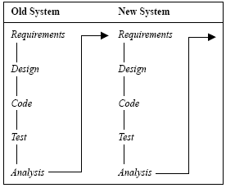
Iterative-Enhancement Model

Slide 18
Full-Reuse Model
Here, maintenance is considered as reuse-oriented software development, where reusable components are used for maintenance and replacements for faulty components.
It begins with requirements analysis and design of a new system and reuses the appropriate requirements, design, code, and tests from the earlier versions of the existing system.
The reuse repository plays an important role in the full-reuse model.
It also promotes the development of more reusable components.

Slide 19
Full-Reuse Model
Old system
New system
Reuse repository
Requirement analysis
Requirement analysis
Design
Design
Source code
Source code
Test data
Test data
The full-reuse model

Slide 20
Full-Reuse Model
The full-reuse model is more suited for the development of lines of related products.
This model takes some initial cost to institutionalize the reuse environment.
The full-reuse model is especially important for the maintenance of component-based systems or reengineering-type projects that are to be migrated onto a component-based platform.

Slide 21
IEEE 1219 Model
The IEEE standard organizes the maintenance process in seven phases.
The phases are classification and identification, analysis, design, implementation, system test, acceptance test, and delivery.
Initially, modification requests are generated by the user, customer, programmer, or the manager of the maintenance team.

Slide 22
IEEE 1219 Model
Analysis
Impleme-ntation
Acceptan-ce test
Delivery
Classific-ation and identification
Design
System test
Modification request

Slide 23
ISO-12207 Model
The ISO-12207 standard organizes the maintenance process in six phases.
The phases are process implementation, problem and modification analysis, modification implementation, maintenance review/acceptance, migration, and software retirement.
Initially, modification requests are generated by the user, customer, programmer, or the manager of the maintenance team.

Slide 24
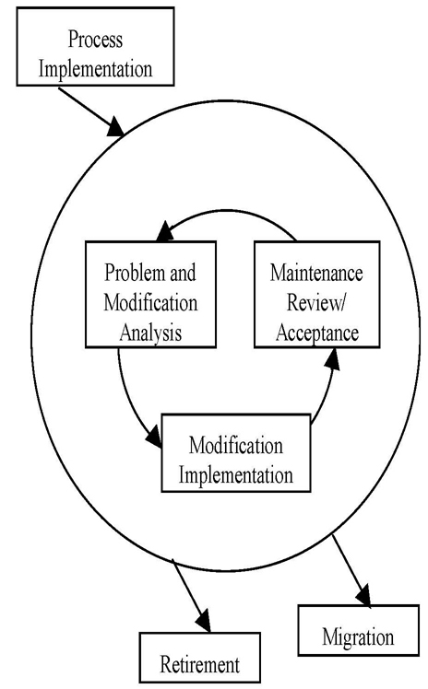
ISO-12207 Model

Slide 25
Maintenance Metrics
The maintenance cost can be reduced if the defects are taken care of in earlier phases of development.
The maintenance cost varies from application to application.
Initially, modification requests are generated by the user, customer, programmer, or the manager of the maintenance team.
Berry Boehm has proposed a formula, ACT, for estimating the maintenance cost as part of the COCOMO estimation model.
ACT is defined as “the fraction of a software product’s source instructions which undergoes change during a year through addition, deletion, or modification.”

Slide 26
Maintenance cost
ACT is related to the number of change requests as follows:
KLOC_{added} + KLOC_{deleted}
ACT = KLOC_{total}
Where KLOC_{added} is the total lines of code added during maintenance. KLOC_{deleted} is the total lines of code deleted during maintenance.
The maintenance effort in person-months can be calculated as follows:
  Maintenance effort = ACT x Development effort
Software projects have different characteristics. The maintenance effort varies from project to project.
Therefore, effort adjustment factors (EAF) are considered for accurate estimation of the maintenance effort. Considering EAFs, the maintenance effort is calculated as follows:
Maintenance effort = ACT x Development x EAF

Slide 27
Maintenance cost
Example 13.1
Assume that the ACT in a software system is 9.5% per year. The initial development cost was Rs. 56 lacs. What is the total cost of the software system if maintenance is performed for 7 years.
Solution:
Initial development cost = 56 lacs
Annual Change Traffic (ACT) = 9.5% per year
Duration of the maintenance = 7 years
Total cost = Initial development cost + 7 x (development cost x 0.095)
= 56.00 + 7 x (56 x 0.095)
= 56 + 37.24
= 93.24 lacs

Slide 28
Software Maturity Index (SMI)
Software maturity index (SMI) finds the stability (i.e., readiness for release) of a software product.
This index is especially useful for assessing release readiness when changes, additions, or deletions are made to existing software systems. SMI is computed as follows.
SMI = M_{t} – (F_{a} + F_{c} + F_{d})/M_{t}
M_{t} is the number of modules/software functions in the current release
F_{c} is the number of modules/functions in the current release that have been changed
F_{a} is the number of modules/functions in the current release that have been added
F_{d} is the number of modules/functions that are deleted in the current release from the previous release.
As SMI approaches 1.0, the product begins to stabilize.SMI prediction may also be used as a metric for planning software maintenance activities.

Slide 29
Why is Reengineering?
In legacy systems, the following symptoms are observed:
  Poor documentation or its nonexistence
  Complexity of the code and program structure
  Inability to satisfy customer requirements
  Low business value
  Obsolete technology
  High maintenance cost
  High frequency of occurrences of failures
  Constant need to update and renovate the system
  Feel obsolete to operate due to aging

Slide 30
What is Reengineering?
Continuous maintenance of these systems becomes tedious and the cost approaches to the business cost.
These systems are too difficult to maintain and enhance continuously and are too important to be discarded because old systems have a high business value.
One possible solution for legacy systems is to transform them onto a modern platform to meet the defined quality goals. Hence, reengineering becomes more and more important.
“Reengineering is the process of analyzing and representing a subject system at a higher level of abstraction to reconstitute it into a form and the subsequent implementation of the new form.”

Slide 31
What is Reengineering?
Reengineering = Reverse engineering + ∆ + Forward engineering
Where ∆ represents the changes made in the candidate system. The reengineering process represents the candidate system at a very high level of representation through reverse

Slide 32
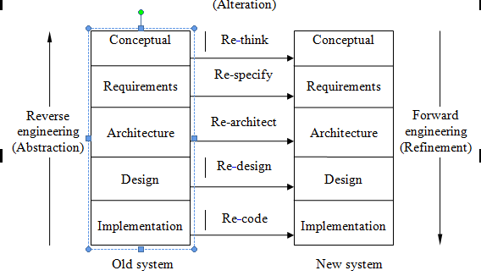
Reengineering Process

Slide 33
Reengineering Activities
Planning for reengineering
Program comprehension for inventory analysis
Redocumentation
Reverse engineering
Restructuring
Forward engineering

Slide 34
Planning for Reengineering
Reengineering process must be carefully planned in advance for their systematic execution, for proper utilization of resources, for managing the required resources, and for maintaining control over reengineering.
Project planning focuses on the investigation of the scope of work and estimation that predicts the project effort, duration, and cost.
Also, it determines staffing and personnel requirements, risk management, change management, effort; and provides support tools and repositories
The existing software products must be analyzed in terms of problem specification, including objectives, motivation, constraints, and business rules.

Slide 35
Program Comprehension for inventory analysis
Program comprehension is the process of acquiring or extracting inventory of the existing application system.
It may be program files, documentation, support tools, human expert within and outside the organization, etc.
Also, it is required to understand the existing and target system development environment, file structures, etc.
Also, it helps in understanding the control flow, data usage, program linking, prototypes, etc.
Frequently in program comprehension the programmer understands domain concepts, but not the code.
The knowledge of domain concepts is based on program use and therefore it is easier to acquire than knowledge of the code.

Slide 36
Re-documentation
Re-documentation or document restructuring is the process of creating a semantically equivalent representation at the corresponding levels of abstraction.
In this aspect, system documents are updated/ rewritten/ replaced to document the target system.
Various documents that may be affected in legacy software include requirement specifications, design and implementation, design decision report, configuration, data dictionary, user and reference manuals, and the change document.
The task of generating documentation is important and can affect the quality of future system maintenance.

Slide 37
Reverse Engineering
Reverse engineering is the process of recovering the design specifications of an existing business system from its implementation and representing it at a much higher level of abstraction .
Reverse engineering techniques can be performed to extract data, architecture, design information, and content of a procedural system.
Reverse engineering techniques provide the means for recovering the lost information and developing alternative representations of a system, such as generation of structure charts, dataflow diagrams, entity-relationship diagrams, etc.

Slide 38
Reverse Engineering
Software artifacts
Parsing and analysis
Restructuring
Extract abstractions
Refine and simplify
Requirement specifications

Slide 39
Restructuring
Restructuring transforms the system from one representation form to another at the same level of abstraction.
Restructuring modifies the code and data that are adaptable to future changes. It preserves semantics and functionality between the new and old representations.
Mainly, it has two major aspects, namely, code restructuring and data restructuring.
Code restructuring produces designs with higher quality than the existing one.
Data restructuring is performed to extract the data items and objects to understand data flow and the existing data structure.

Slide 40
Forward Engineering
Once reverse engineering has been performed and all important artifacts have been recovered, forward engineering is performed.
Forward reengineering is the traditional process of moving from high-level abstraction using logical design to physical implementation.
Forward engineering moves from a higher-level abstract representations and design details to implementation level of the system.
Design details such as object models, use case diagrams, pseudo codes, etc., can be converted to object-oriented programming languages.

Slide 41
Software aging
Due to repeated maintenance, software performance degrades; more failures occur; software becomes incompatible with changes and is unable to run on different platforms; and more resources get consumed.
software aging is a phenomenon plaguing running complex software systems, which results in performance degradation and/or an increasing failure rate.
Causes of increasing software aging are: continuous change and patching work which damages the software structure; increasing complexity and size of software due to upgradation; insufficient and ignorant documentation after upgradation; increasing file size; unnecessary storage of buffer and swap space; and failure to release allocated memory.

Slide 42
Software aging
Symptoms of software aging are difficulty in keeping up the software to satisfy business needs, degrading performance, and elusion of more bugs that may lead to failures.
There are various methods to prevent software aging, such as design for change, proper documentation, preventive maintenance, maintaining structure, and applying fault-tolerance technique.
Fault-tolerance technique is employed proactively to prevent performance degradation or failures of the software system.
It involves, occasionally or periodically, stopping the running software, cleaning its internal state or environment, and restarting it and is known as software rejuvenation.

Slide 43
Software aging
Software rejuvenation is a cost-effective approach to remove aging effects and avoid aging-related failures.
Aging effects are the consequences of error accumulation in terms of leaked resources or corrupted states resource usage of the operating system, such as free physical memory, used swap space, size of file, and process tables.
Aging-related failure is a particular class of software faults that manifest their effect only after a long period of execution (e.g., an operation that allocates memory fails, causing the crash of a process).

